Slide 1

Project Work 2(19AI703) – Review 2
COGNITEX: An Intelligent Cognitive Load–Adaptive Learning and Productivity System
Submitted by:
BHARATHGANESH S (212222230022)
2022-2026 Batch
TEAM NO: 129
Under the guidance of:
Dr. Saravanan N
Assistant Professor,Department of AIML
DEPARTMENT OF ARTIFICIAL INTELLIGENCE AND DATASCIENCE
SAVEETHA ENGINEERING COLLEGE
(Autonomous Institution – UGC, Govt. of India)
(Affiliated to Anna University, Approved by AICTE - Accredited by NBA & NAAC – ‘A’ Grade - ISO 9001:2015 Certified)
Saveetha Nagar, Thandalam, Chennai-602 105, TamilNadu, INDIA.

Slide 2
Agenda
Introduction
Statement of the Problem
Purpose of your project
Methodology
Architectural Diagram
Flow
Algorithm used
Design - Use Case Diagram, Class Diagram,Sequence
Implementation
Important code segments
Output, Results
Test Cases
Conclusions
Future work
References

Slide 3
Introduction
AI-driven learning systems are transforming education by adapting content based on learner behavior and performance.
Cognitive Load Theory helps balance mental effort to improve understanding and retention during learning.
Machine Learning and Generative AI enable real-time analysis and personalized learning interventions.
Adaptive intelligent tutoring systems enhance engagement, reduce overload, and improve overall learning outcomes.

Slide 4
Statement of the Problem
Traditional learning systems apply the same content and pace to all learners, ignoring individual cognitive differences and mental workload variations.
Manual assessment of learner engagement and fatigue is inefficient, subjective, and unable to adapt in real time during learning sessions.
Existing adaptive tutoring systems lack continuous behavioral data collection and fail to respond dynamically to changing cognitive states.
There is a need for an intelligent, automated system that can monitor cognitive load in real time and provide personalized learning interventions.

Slide 5
Purpose of the project
To automatically detect a learner’s cognitive load using real-time behavioral data such as typing speed, errors, and inactivity.
To adapt learning strategies dynamically by adjusting difficulty, pacing, or recommending breaks based on the learner’s mental state.
To enhance learning outcomes by providing personalized, AI-generated feedback and guidance without manual input.
To build a scalable, privacy-preserving intelligent learning system suitable for real-world educational environments.

Slide 6
Methodology
Collect real-time user interaction data (keyboard and mouse).
Use a trained ML model to classify cognitive load (Underload / Optimal / Overload).
Apply agent-based decision logic to decide difficulty, breaks, or pacing.
Provide adaptive feedback and advice using Generative AI.

Slide 7
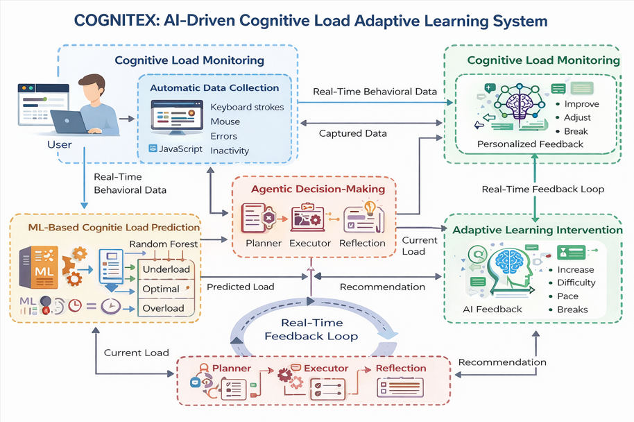
Architecture Diagram/Flow

Slide 8
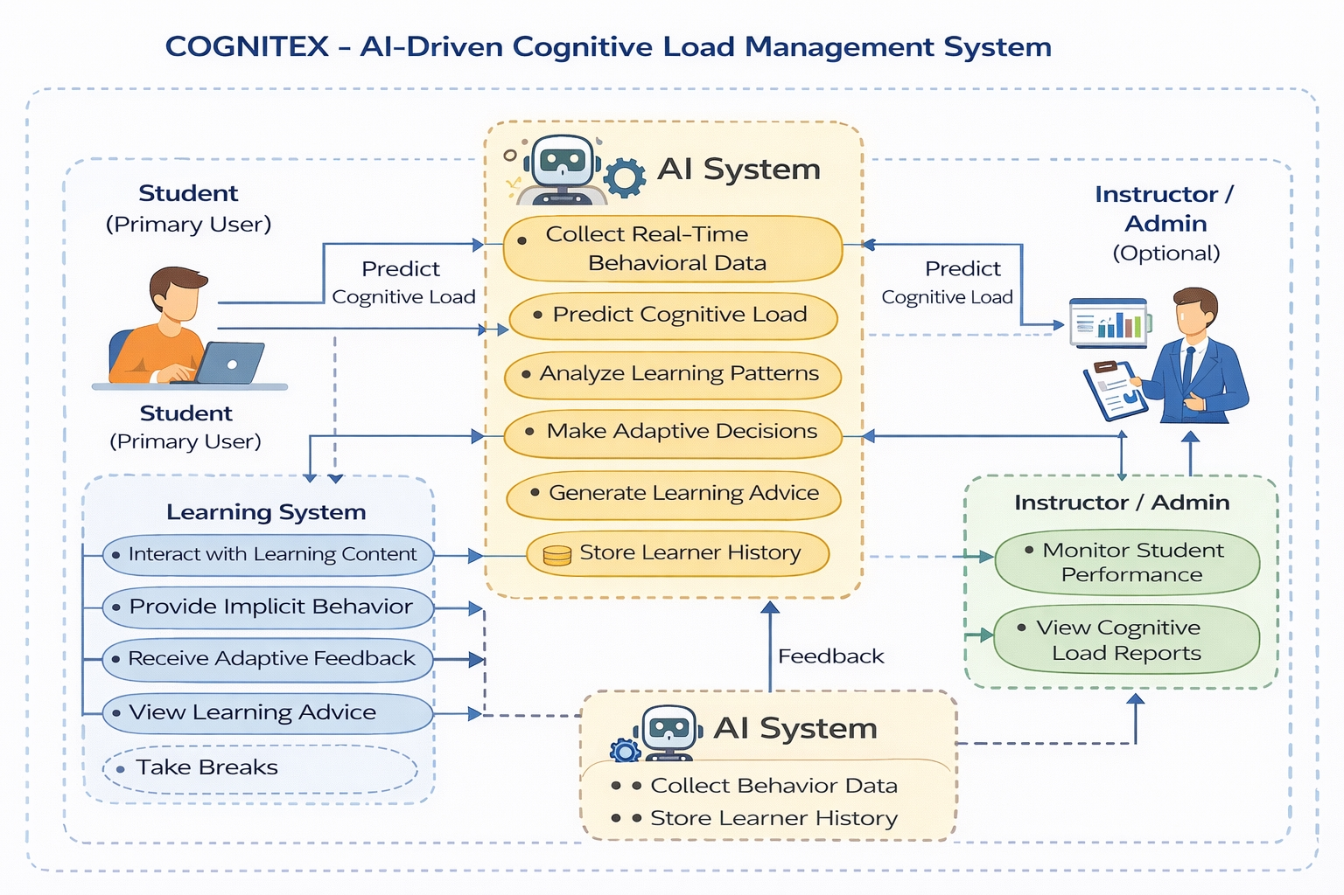
Design-Use Case Diagram
Use case Diagram
A use case diagram is a graph of actors set of use cases enclosed by a system boundary, communication associations between the actors and users and generalization among use cases.

Slide 9
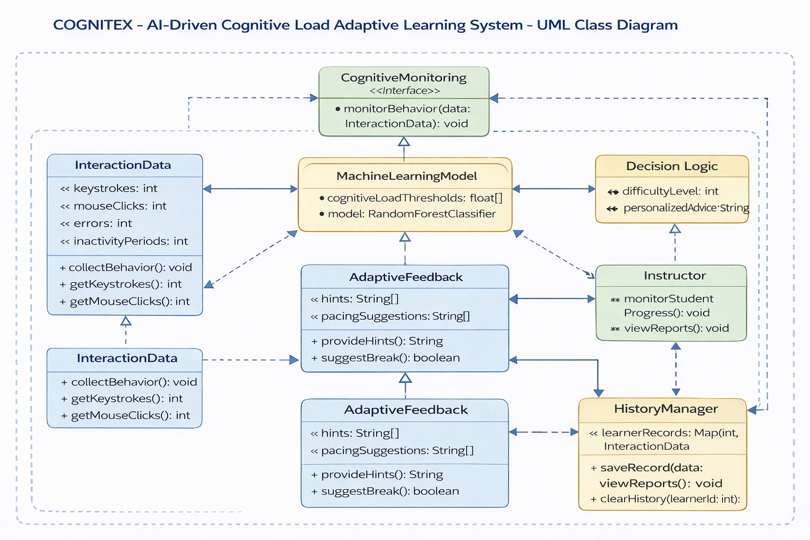
Design-Class Diagram
Class Diagram
A class is a representation of an object and, in many ways; it is simply a template from which objects are created. Classes form the main building blocks of an object-oriented application.

Slide 10
Hardware and software selection
HARDWARE ENVIRONMENT
• Processor : Intel Core i5 (or equivalent)
• Hard Disk : 350 GB minimum
• RAM : 4 GB (minimum)
• Keyboard : 110 keys enhanced
• Mouse : Optical Mouse
SOFTWARE ENVIRONMENT
• Operating System : Windows 11
• IDE : PyCharm / VS Code
• Frontend : HTML, CSS, JavaScript
• Backend : Python (FastAPI)
• Machine Learning : Scikit-learn, TensorFlow
• AI / NLP : Hugging Face Transformers

Slide 11
Implementation
Automatic Data Collection:
Keyboard and mouse activities are tracked in real time using JavaScript to capture typing speed, errors, and inactivity without manual input.
Machine Learning Prediction:
Collected data is sent to the backend where a trained ML model predicts the learner’s cognitive load (Underload, Optimal, Overload).
Agentic Decision Logic:
AI agents analyze current and past cognitive states to decide actions like increasing difficulty, maintaining pace, or suggesting breaks.
Adaptive Feedback Generation:
A Generative AI module provides personalized learning advice based on decisions and historical behavior.
Real-Time Response Display:
The frontend continuously updates cognitive load, decisions, execution status, and advice for an interactive learning experience.

Slide 12
Important Code segments
Backend Cognitive Load Prediction (ML Layer)
import pandas as pd
import joblib
model = joblib.load("ml/cognitive_model.pkl")
def predict_cognitive_load(data):
"""
Predicts cognitive load using user behavior data
"""
df = pd.DataFrame([data])
prediction = model.predict(df)[0]
return prediction
Agent Decision & Execution Logic (Agentic AI Layer)
load_history = []
def update_history(load):
load_history.append(load)
return load_history[-5:]
def planner_agent(current_load):
history = update_history(current_load)
if history.count("Overload") >= 3:
return "Force break"
elif history[-2:] == ["Underload", "Underload"]:
return "Increase difficulty"
elif current_load == "Optimal":
return "Maintain pace"
else:
return "Reduce difficulty"

Slide 13
Important Code segments
Frontend Automatic Behavior Tracking (No Manual Input)
// frontend/tracker.js
let keystrokes = 0;
let errorCount = 0;
let lastActivity = Date.now();
const startTime = Date.now();
document.addEventListener("keydown", (e) => {
keystrokes++;
if (e.key === "Backspace") errorCount++;
lastActivity = Date.now();
});
document.addEventListener("mousemove", () => {
lastActivity = Date.now();
});
function collectMetrics() {
return {
typing_speed: Math.round(keystrokes / ((Date.now() - startTime) / 60000)),
time_on_task: Math.round((Date.now() - startTime) / 1000),
error_count: errorCount,
inactivity: Math.round((Date.now() - lastActivity) / 1000)
};
}

Slide 14
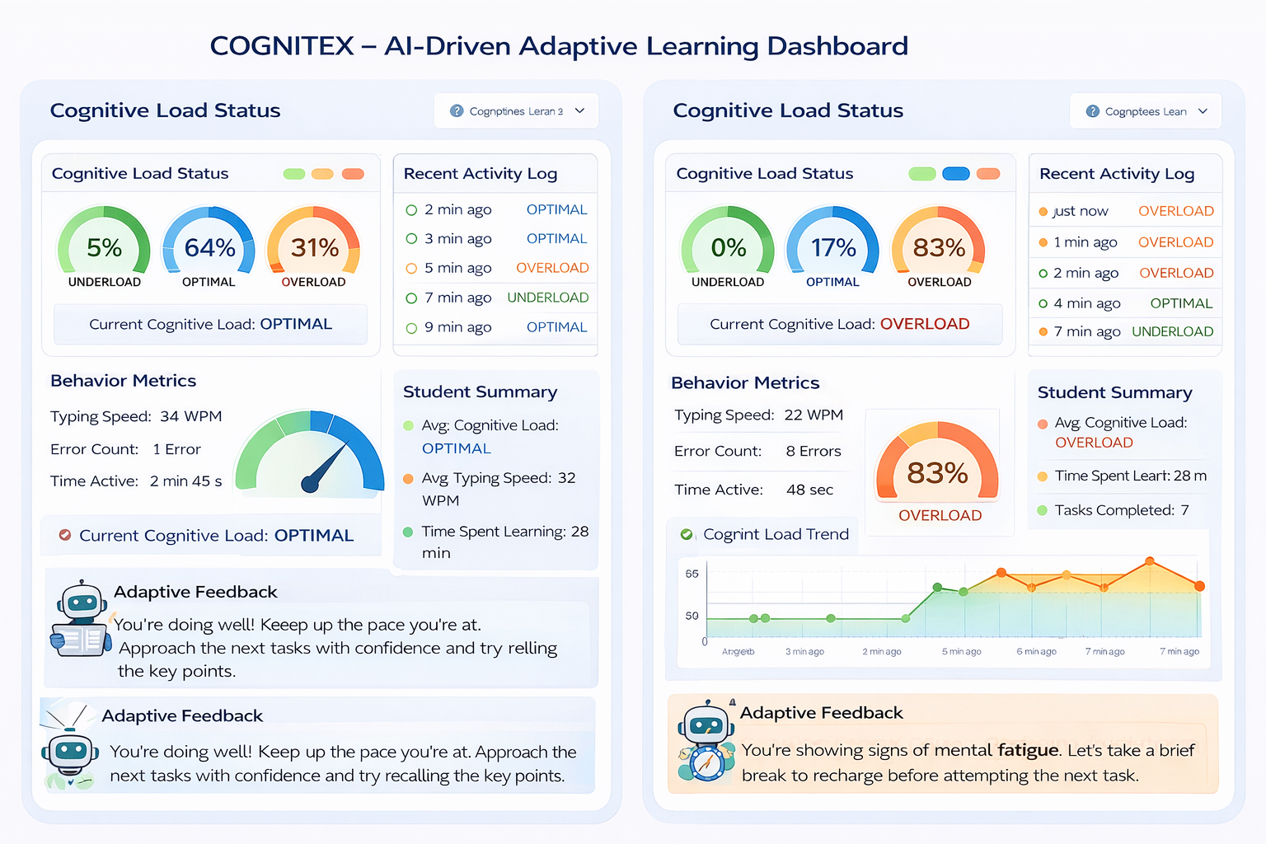
Output
OUTPUT:
Sample Output 1:

Slide 15
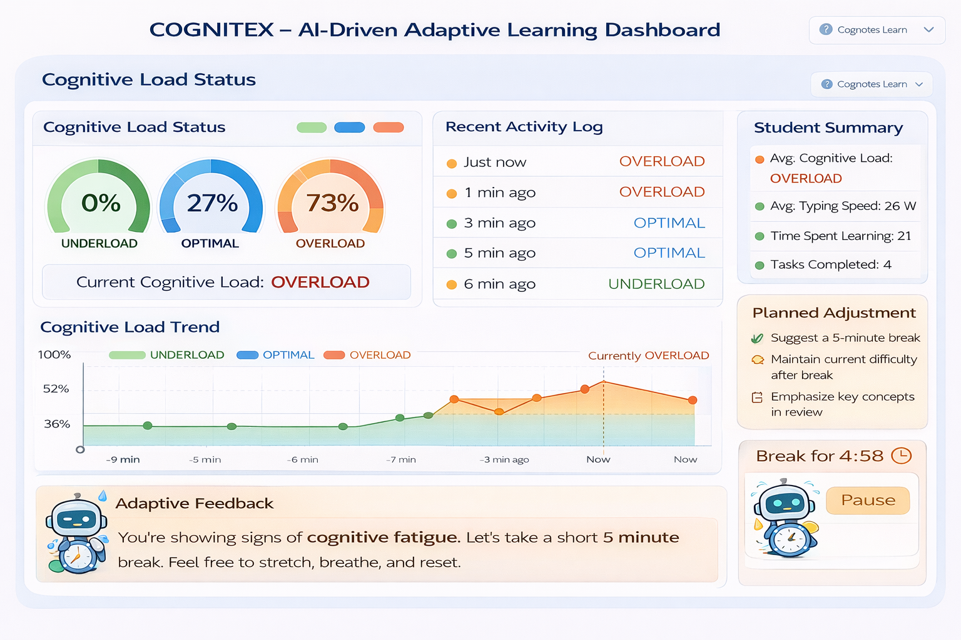
Output
OUTPUT:
Sample Output 2:

Slide 16
Results
The system successfully detects cognitive load levels (Underload, Optimal, Overload) in real time using user behavior data like typing speed and inactivity.
Adaptive decisions are generated automatically, adjusting task difficulty or suggesting breaks based on the learner’s cognitive state.
Personalized AI feedback improves engagement by providing timely learning advice tailored to the user’s current condition.
Overall, the system enhances learning efficiency and user focus by preventing mental fatigue and maintaining an optimal learning pace.

Slide 17
Conclusion
This project successfully demonstrates an AI-driven cognitive load management system that automatically analyzes user behavior and provides adaptive learning interventions. By combining machine learning, agent-based decision-making, and real-time interaction tracking, the system enhances learner engagement and reduces cognitive overload.
Overall, the proposed system proves to be scalable, cost-effective, and suitable for modern intelligent tutoring environments. It lays a strong foundation for future enhancements in personalized education using AI and real-time analytics.

Slide 18
Future Work
Multimodal Cognitive Sensing
Integrate eye-tracking, facial expressions, and voice analysis to improve accuracy of cognitive load detection.
Personalized Learning Models
Adapt the system to individual learners using long-term behavior patterns and reinforcement learning.
Mobile & Wearable Integration
Extend the platform to mobile apps and smart wearables for real-time cognitive monitoring.
Advanced Analytics Dashboard
Provide detailed visual insights for learners and educators to track progress and mental effort trends.
.

Slide 19
References
[1] Sweller, J., Ayres, P., & Kalyuga, S., Cognitive Load Theory, Springer, 2019.
(Foundational work on cognitive load concepts.)
[2] Plass, J.L., Moreno, R., Brünken, R., Cognitive Load Theory and Instructional Design, Springer, 2020.
[3] Dikker, S., et al., “Brain-to-Text: Automated Cognitive Load Estimation in Learning Environments,” IEEE Transactions on Learning Technologies, 2023.
[4] Zhai, X., et al., “Adaptive Learning Path Planning Based on Learner Cognitive States,” IEEE Access, 2024.
[5] Li, Y., et al., “Integrating Behavioral Analytics and Machine Learning for Real-Time Learner Engagement Detection,” ACM Transactions on Interactive Intelligent Systems, 2023.
[6] Zhou, R., et al., “Towards Generative AI–Enabled Personalized Tutoring Systems,” IEEE Transactions on Education, 2024.

Slide 20
References
[7] Hall, M., et al., “Agent-Based Intelligent Tutoring Systems: A Survey,” International Journal of Artificial Intelligence in Education, 2023.
[8] Hu, H., et al., “Real-Time Prediction of Cognitive Load Using Physiological and Behavioral Signals,” IEEE Journal of Biomedical and Health Informatics, 2022.
[9] Aljawarneh, S., “Machine Learning in Educational Data Mining for Adaptive Learning Systems,” IEEE Access, 2023.
[10] Gök, T., et al., “Generative AI for Immediate Feedback in Intelligent Tutoring,” Educational Technology & Society, 2023.
[11] Nguyen, A., et al., “Reinforcement Learning for Personalized Intervention in Adaptive Learning Systems,” ACM International Conference on Learning Analytics & Knowledge, 2024.
[12] Singh, H., & Kulkarni, S., “Cognitive Load–Aware Automatic Intervention System for Online Learning,” Computers & Education, 2023.

